Slide 1

Process improvement study for a hospital
Applying process mining methods on a hospital’s data:
Examining a hospital's data by applying various filters to the data and interpreting the statistical results using Disco software, identifying problems in the process, designing new processes that will increase efficiency and drawing the flowchart of new process designed with Microsoft Visio.
Link of the dataset: https://github.com/selcukeskil/Process-improvement-study-for-a-hospital/blob/main/Process%20data%20of%20the%20hospital.xlsx

Slide 2
Part 1
Process Maps
Process Map Animation
Examining Process Data
Process Filtering
Examining Patient Routes
Analysis By Age Groups
Examining Of Time Consuming Processes
Examining 3 Most Used Routes
Examining Two Activities With The Highest Frequency In The Process

Slide 3
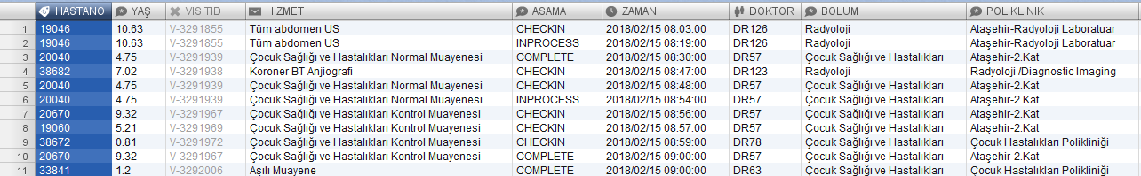
Uploading the process data to Disco
Case ID
Remove
Activity
Timestamp
Resource
Other
Other
Other
Other
While uploading the process data to Disco software, we defined the columns of the data as you see above.

Slide 4
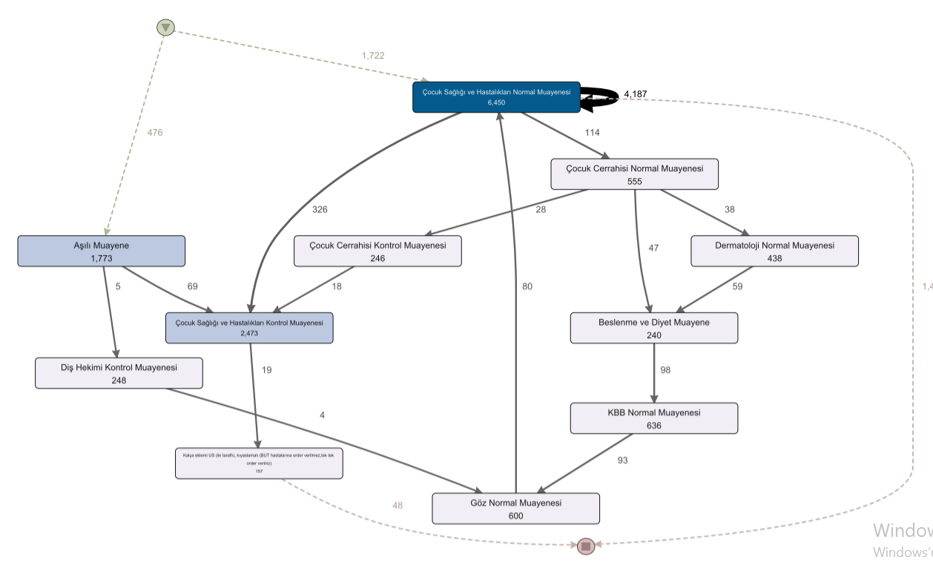
Process Map
Process map showing frequencies when Activity setting is 12%
1,437

Slide 5
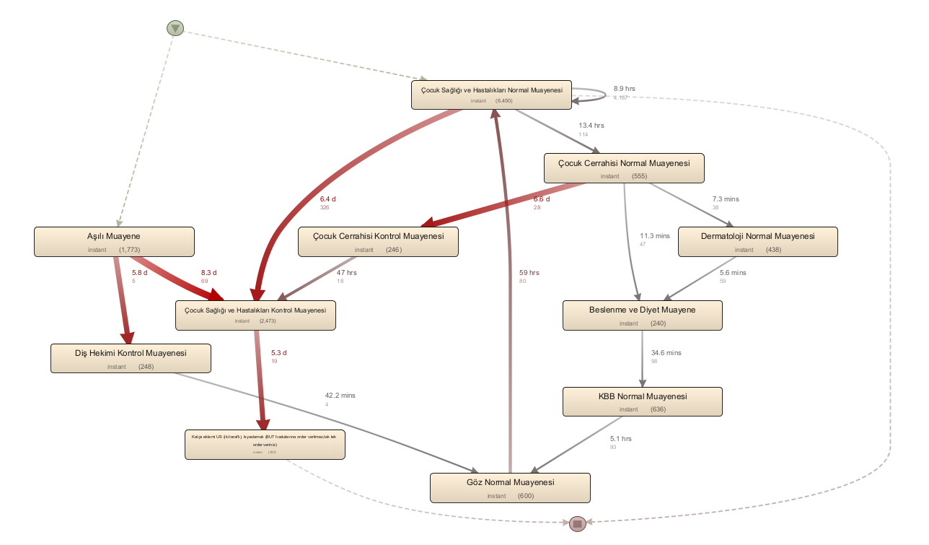
Process map showing time performances when Activity setting is 12%
Routes that take longer time appear darker

Slide 6
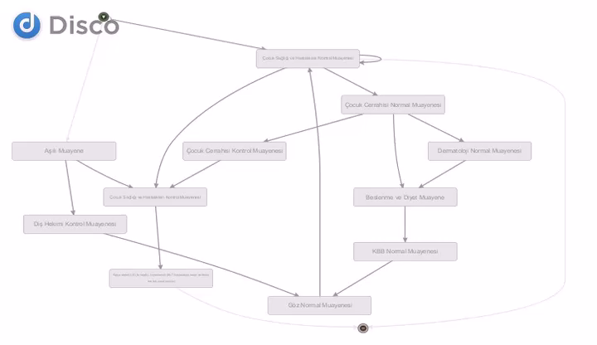
Process map animation

Slide 7
Examining Process Data
The most frequently used activities in the process map are; Pediatric Health and Diseases Normal Examination, Pediatric Health and Disease Control Examination (visible from the animation).
More homogeneous frequency distribution is seen in other activities of the process (visible from the animation)

Slide 8
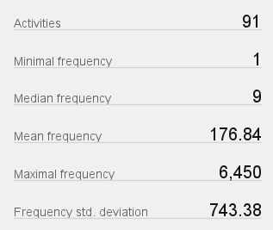
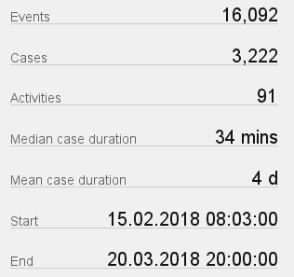
There are 91 activities in the process.
An average of 176 operations (procedures) are made in each activiy. In other words, an average of 176/3 medical examinations are performed in each activity.
The maximum number of processes in an activity is 6450.
We have about 35 days of data.
A total of 3222 patients entered the process.
Each patient stayed in the process for an average of 4 days.

Slide 9
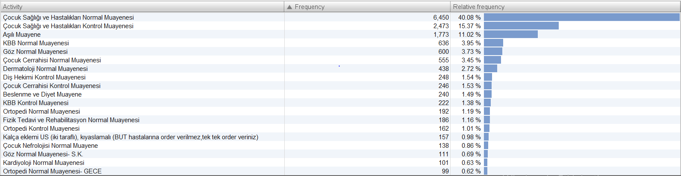
Frequency Distribution of Activities
3 activities with the highest number of operations; Pediatric Health and Diseases Normal Examination, Pediatric Health and Diseases Control Examination, Vacination Examination.

Slide 10
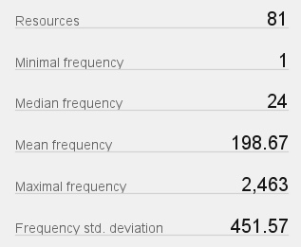
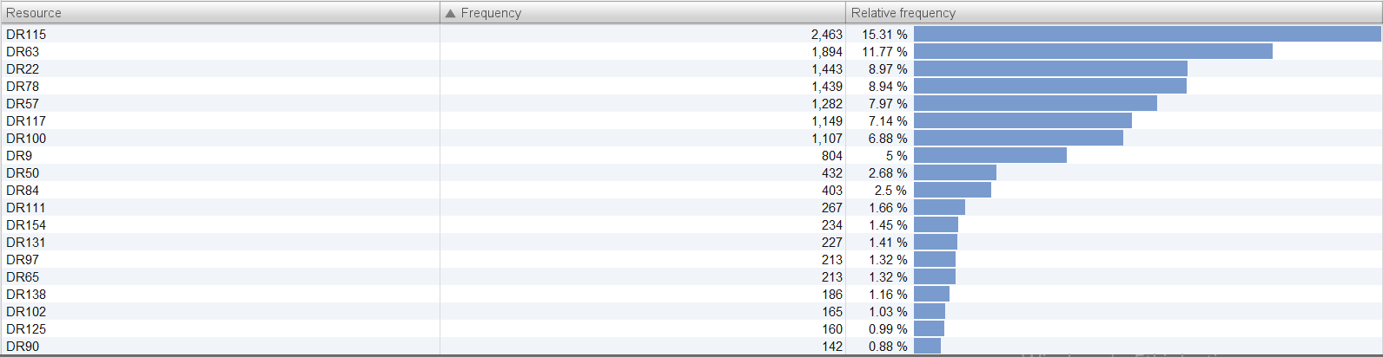
Examining the statistics of doctors
There are 81 doctors in the process. Each doctor performs an average of 198 operations (procedures).
The doctor who performed the most procedures, DR115, performed 2463 procedures, which is approximately 15% of total procedures.

Slide 11
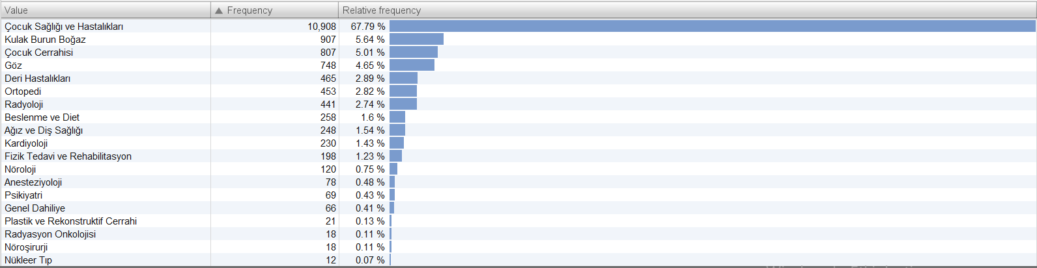
The ratios of the number of operations performed in the departments
Pediatric Health and Diseases is the department with the most operations (procedures) with 67.79%. This is followed by the Department of Otorhinolaryngology with 5.65%.

Slide 12
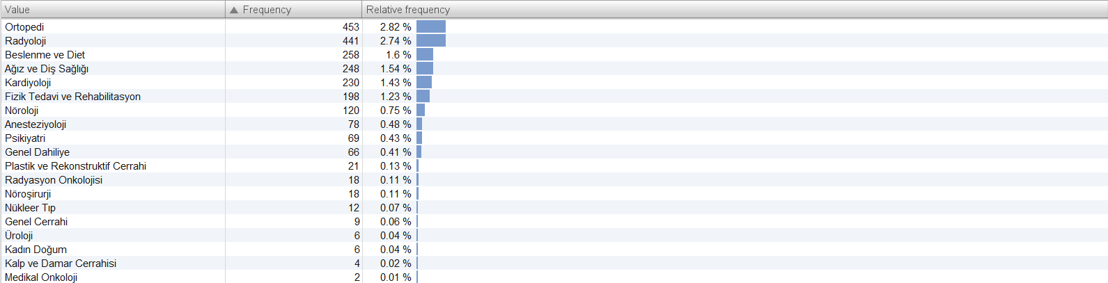
Least Operation Observed Departments
Medical Oncology is the department with the least operation.

Slide 13
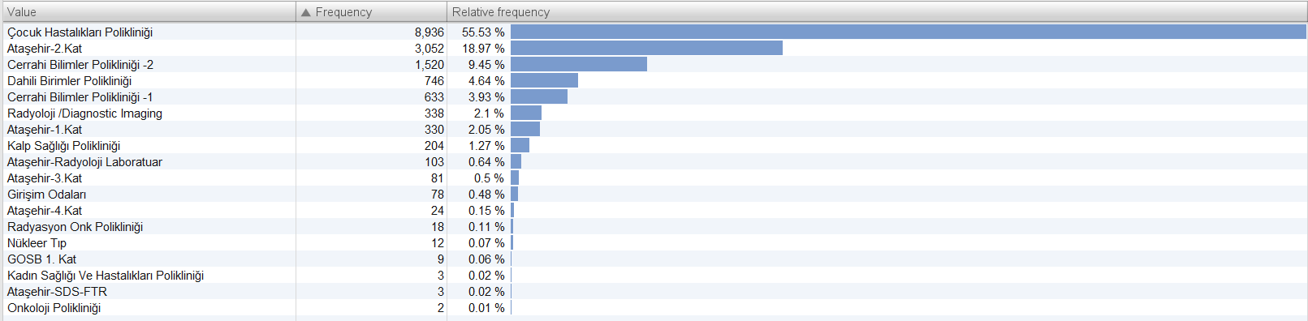
Polyclinics with the most procedures
Pediatrics Polyclinic is the polyclinic with the most procedures with 55.53%. This is followed by Ataşehir 2nd floor with 18.97%. The polyclinic with the least operation is the Oncology Policlinic.

Slide 14
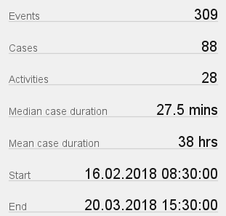
Process Filtering
There are 12 departments with less than 100 frequencies. If we filter these departments;
In these 12 departments, only 88 patients were seen during the whole process.
The average duration of stay in the process of these patients is 38 hours.

Slide 15
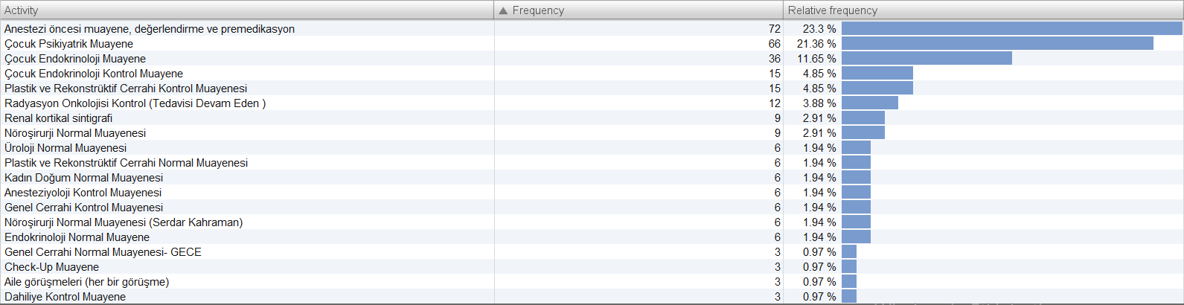
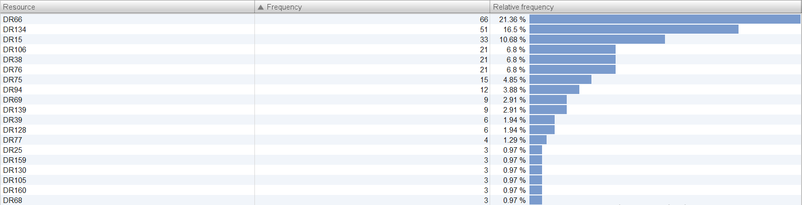
The Most Done Activities In The Departments With Few Patients
The Doctors Working The Most In The Departments With Few Patients

Slide 16
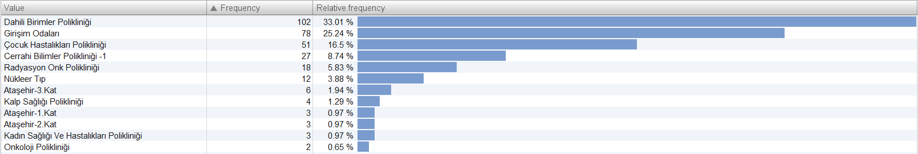
Polyclinics including departments which has low number of patients

Slide 17
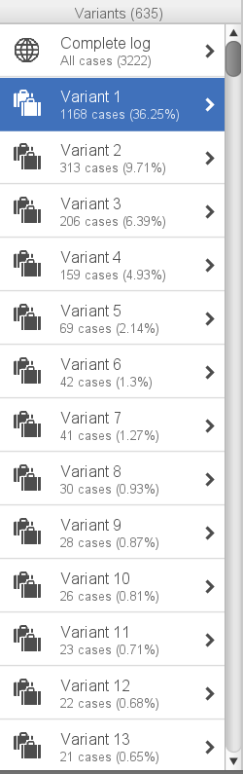
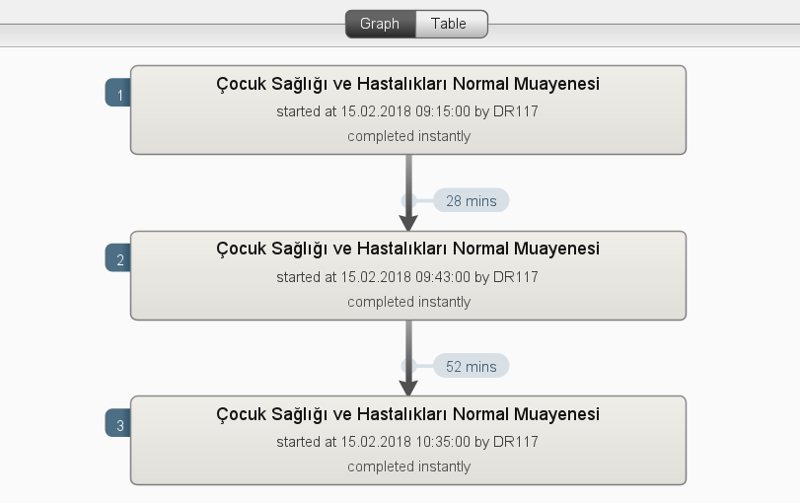
Examining Patient Routes
The most common route followed by the patients is the route we see above with a rate of 36%.
It consists of check-in, inprocess and complete procedures (operations).

Slide 18
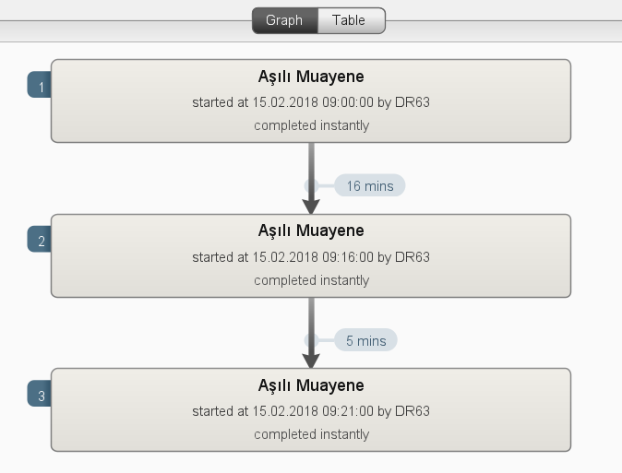
The second most common route is as follows.
As before, it consists of check-in, inprocess and complete procedures.

Slide 19
Analysis By Age Groups
For examination, patients were divided into age groups as follows:
0-3 / 3-6 / 6-9 / 9-12 / 12-15 / Over 15

Slide 20
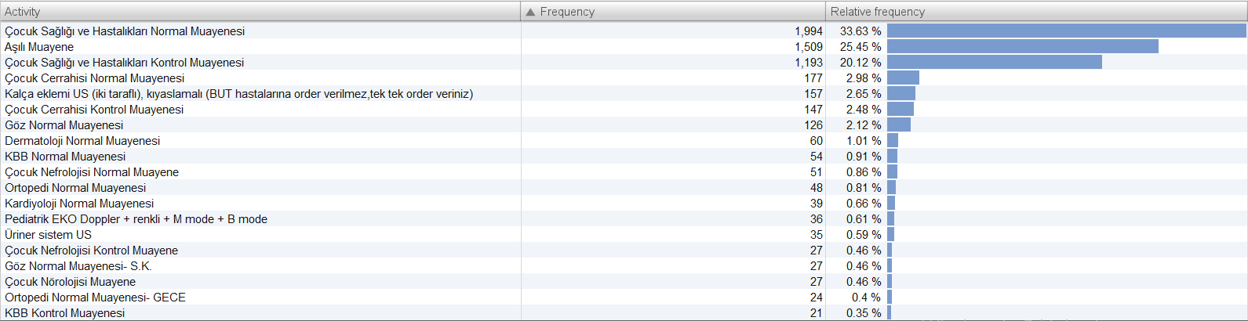
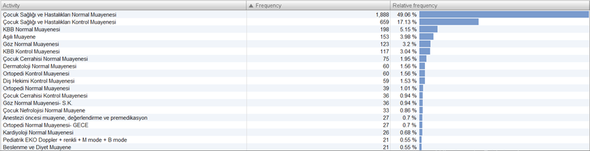
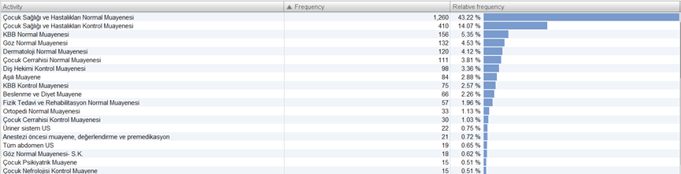
Activity Distribution
0-3
Vaccination examination frequency in the 0-3 age group is higher than in other groups. This frequency decreases with increasing age.
As age increases, the rate of Otorhinolaryngology normal examinations and eye normal examinations increases compared to other activities.
3-6
6-9

Slide 21
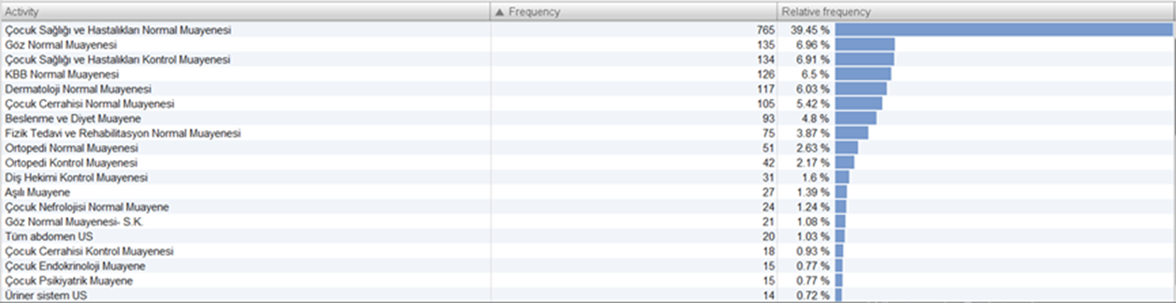
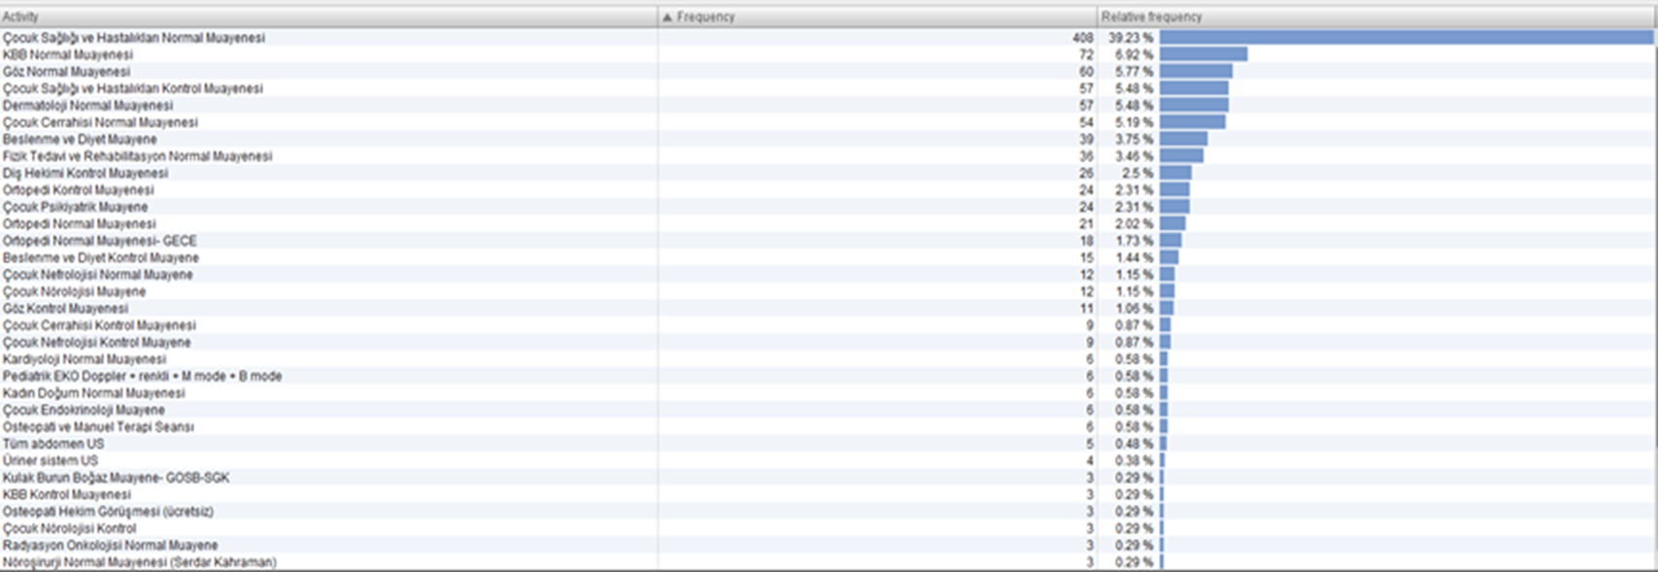
Activity Distribution
9-12
12-15
Over 15

Slide 22
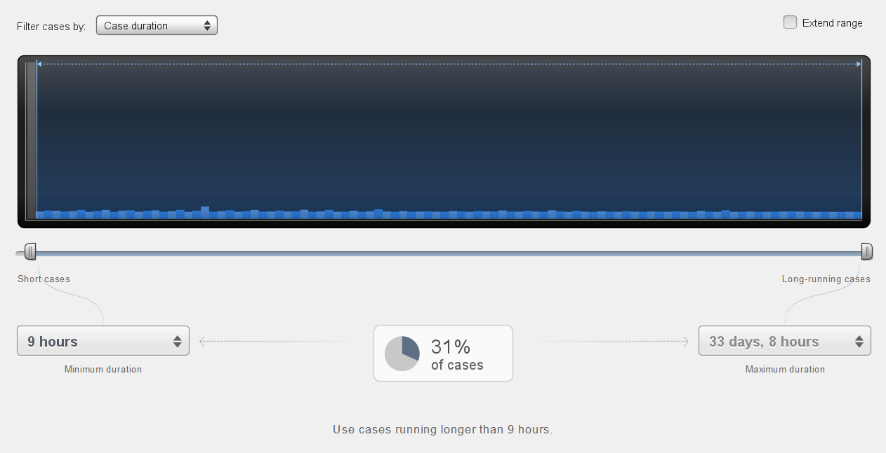
Examining of processes that take long time
31% of patients spend more than 9 hours in the process.

Slide 23
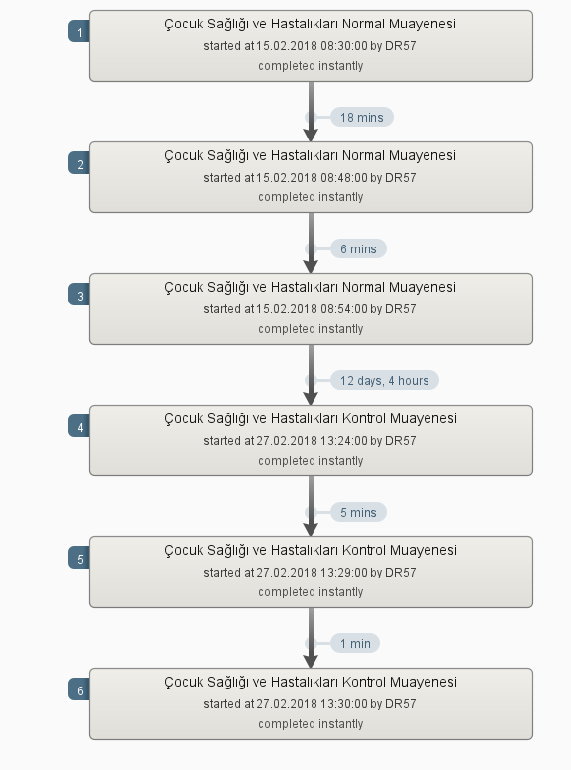
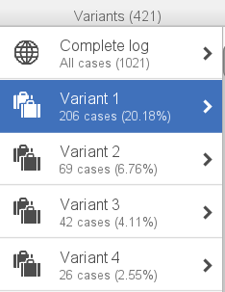
20% of these patients (patients who spend more than 9 hours in the process) follow the route you can see on the right (Variant 1)
The reason for 20% of the cases of staying in the system for more than 9 hours is that the post-examination controls are made after a long time.

Slide 24
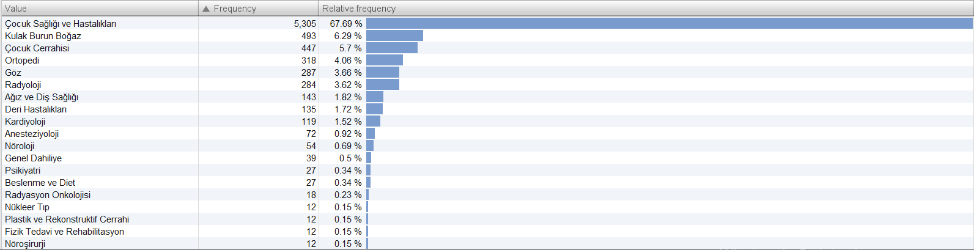
The departmental distribution table of operations lasting more than 9 hours is as above.
The duration of a patient’s stay in the process is longer in the departments which has a control procedure.
Examples include pediatrics or orthopedics.

Slide 25
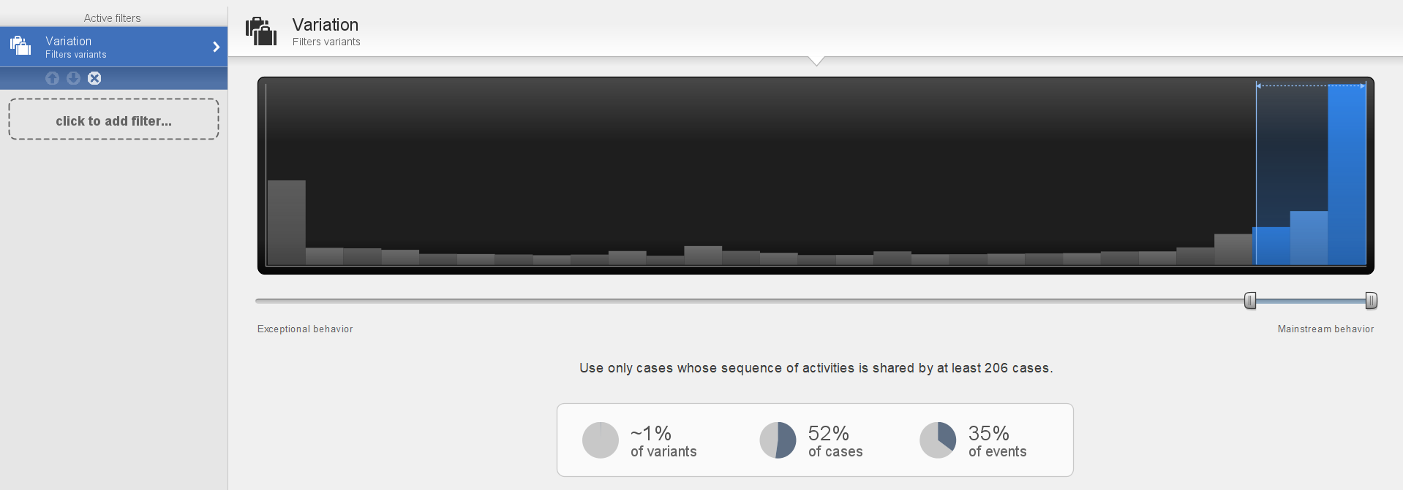
Examining the 3 most used routes

Slide 26
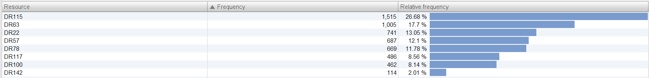
The most used polyclinics in these 3 routes are as above.
In other words, these are the polyclinics that are used the most in the process.
In the 3 most used routes, the most working (operating) doctors are as above.

Slide 27
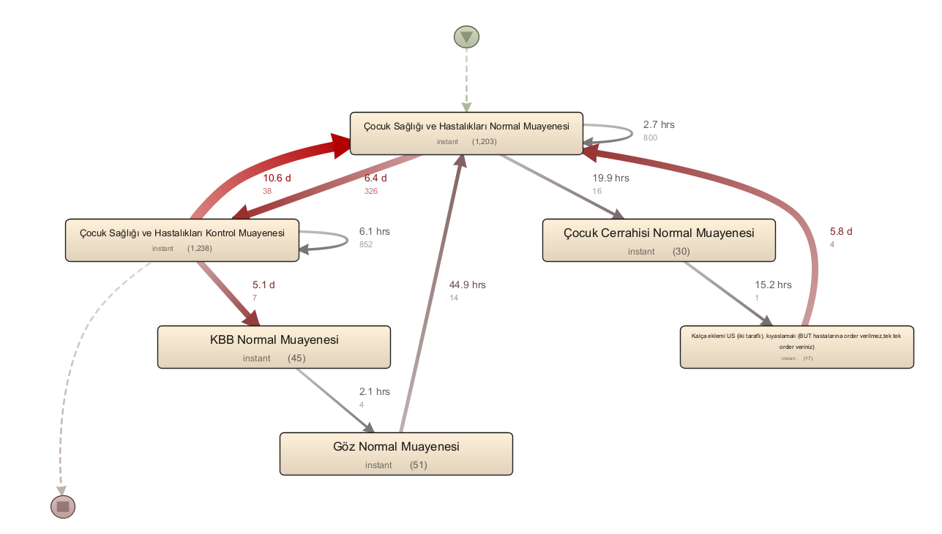
Examining the two activities with the highest frequency in the process
We filtered the two most used activities in the process: Pediatric Health and Diseases Normal Examination, Pediatric Health and Diseases Control Examination.
It took an average of 6.4 days for the patients to go to the Pediatric Health and Diseases Control Examination after the Pediatric Health and Diseases Normal Examination. After the Pediatric Health and Diseases Control Examination, it took an average of 10.6 days for them to go to the Pediatric Health and Diseases Normal Examination.

Slide 28
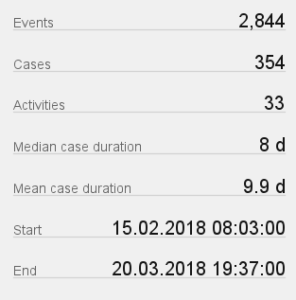
The average duration of stay in the system of patients who experience processes involving these two activities is 9.9 days.
This is much more than the average length of stay of all patients throughout the general process of 4.4 days.

Slide 29
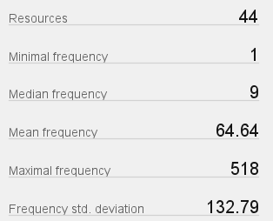
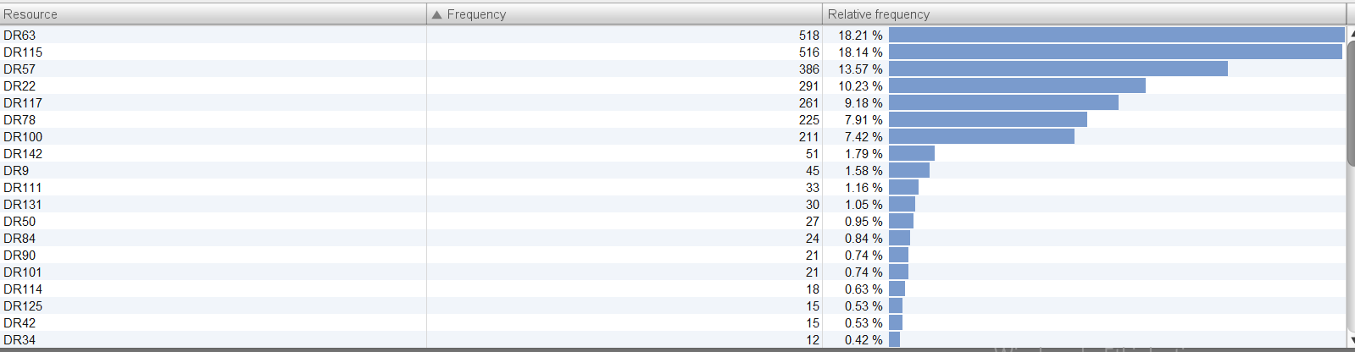
Below is the distribution of the doctors working (operating) the most in the two most used activities we selected.
The doctor who worked the most in these activities performed 518 procedures (operations). Among these activities, doctors performed an average of 64 procedures.
Doctors who perform the most operations perform about 10 times the average.
Notes:
Yani ortalama 64/3 tane muayene yapmış.

Slide 30
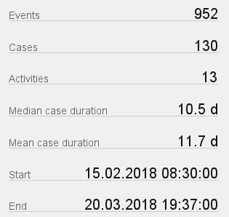
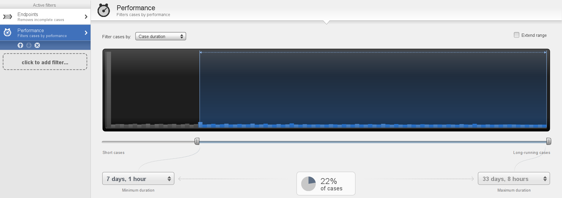
The procedures of half (130 people) of those (263 people) who go from the Pediatric Normal Examination to the Pediatric Control Examination take longer than 7 days.

Slide 31
Part 2
The two activities with the most frequency in the process
Repeated normal examinations
Workload Balancing
Length of periods between normal examination – control examination
Interpretation by days
Less used departments
Departments in more than one polyclinic
Waiting and examination times

Slide 32
The two activities with the most frequency in the process
We filtered the two most used activities in the process: Pediatric Health and Diseases Normal Examination, Pediatric Health and Disease Control Examination.

Slide 33
Below is the distribution of the doctors working the most in the two most used activities we selected.
The doctor who worked the most in these activities performed 518 procedures. Among these activities, doctors performed an average of 64 procedures.
In other words, doctors who perform the most procedures are about 10 times more than average.
Notes:
Yani ortalama 64/3 tane muayene yapmış.

Slide 34
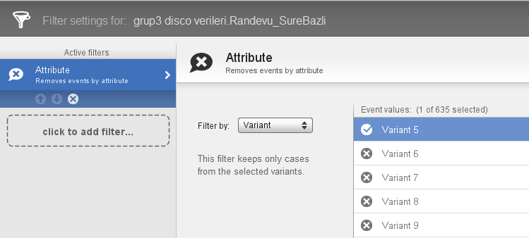
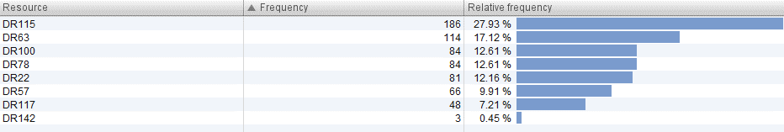
Repeated normal examinations
96 patients returned to normal examination. This number corresponds to 3% of all patients.
The table shows the doctors who performed more than one normal examination for the same patient. These doctors can be consulted about this issue.
If the reason is that certain doctors are not successful in the examination, it can be tried to increase the quality of examination.
Doctors examining patients who repeatedly come for a normal examination

Slide 35
It is seen that DR115 and DR63, seen in the table above, are the 2 doctors who performed the most examinations in the entire process.
Since these doctors do too many examinations, it may cause a decrease in examination times and examination quality, and this may cause patients to return for another nomal examination.
This situation can be solved by making the workload of doctors more homogeneous.
Doctors who examinated the most patients throughout the process

Slide 36
Workload balancing
To homogenize the workload:
If the hospital does not have an appointment system, an appointment system can be developed as follows:
In the patient appointment system, the number of patients that each doctor can see daily should be limited or reduced if there is already a limit.
If the doctor preferred by the patient on the date he wants to make an appointment is suitable, an appointment is made with that doctor. If preferred doctor is not available, the patient can be encouraged to make an appointment with a different doctor on the same date or with the doctor of his choice on a different date.
This can be done with a message box in online systems.
→ As a result of this change, it is checked whether the patients are homogeneously distributed to the doctors and whether the normal examination repetitions are reduced.

Slide 37
Length of periods between normal examination – control examination
The time from normal examinations to control examinations is very long (6.4 days for Pediatric Health and Diseases Department)
Doctors can be consulted whether this delay is due to doctor busyness or because patients arrive late for control examinations than recommended.
If the reason is doctor busyness, this problem will be solved when the workload is equalized.

Slide 38
If patients delay coming to the control:
The doctor enters the information in the appointment system, in how many days the patient’s control examination should be done.
When the patient makes an appointment for the control examination, the appointment system makes the appointment as close as possible to the date suggested by the doctor.
If the appointment dates given by the system are far from what the doctor recommends, a record is created about the situation.

Slide 39
Interpretation by days
When we look at the days, the number of patients varies.
Especially on Saturdays, it is seen that the number of patients is very high and on Sundays it is low.
Examination limits for Saturday can be reduced, or the patient who wants to make an appointment for Saturday will be shown a message box that Saturday is full and Sunday is empty.
A fee reduction may be provided to encourage patients to come on Sunday.
 | Pazartesi | Salı | Çarşamba | Perşembe | Cuma | Cumartesi | Pazar
Öğleden Önce | 32 | 36 | 29 | 31 | 29 | 61 | 7
Öğleden Sonra | 42 | 28 | 41 | 28 | 32 | 57 | 9
Toplam | 74 | 64 | 70 | 59 | 61 | 118 | 16
 | Haftaiçi | Haftasonu
Öğleden Önce | 31,4 | 34
Öğleden Sonra | 34,2 | 33

Slide 40
Less used departments
There are 12 departments with less than 100 frequencies. If we filter these departments;
Only 88 patients were seen in 12 departments during the entire process.
Solution Suggestion:
Closing the departments with few patients and directing the patients who need these departments to other hospitals
Merging departments that will not create organizational problems in the same polyclinic / floor

Slide 41
Benefits of this solution
The patient load of polyclinics with closed or merged departments will be reduced.
Also, by closing departments or merging underutilized departments elsewhere; personnel costs, electricity, water and heating costs arising from the settlement will decrease. In addition, space will be saved.
Polyclinics with few patients
Examples
6 patients came to the radiation oncology department during the whole process, and 1 patient came to the medical oncology department during the whole process. Both departments have polyclinics. We can combine these departments in a single polyclinic under the name of «Oncology Polyclinic». So, labor and space can be saved.
Nuclear medicine department had 4 patients during the whole process. By closing this department, patients in need can be directed to other hospitals.

Slide 42
Departments in more than one polyclinic
There are departments in more than one polyclinic in the process.
For example, the ophthalmology department is available in both polyclinics in this table.
For example, general internal medicine department is available in all 4 polyclinics in this table.
Organizational integrity can be achieved by combining such departments in a single polyclinic.

Slide 43
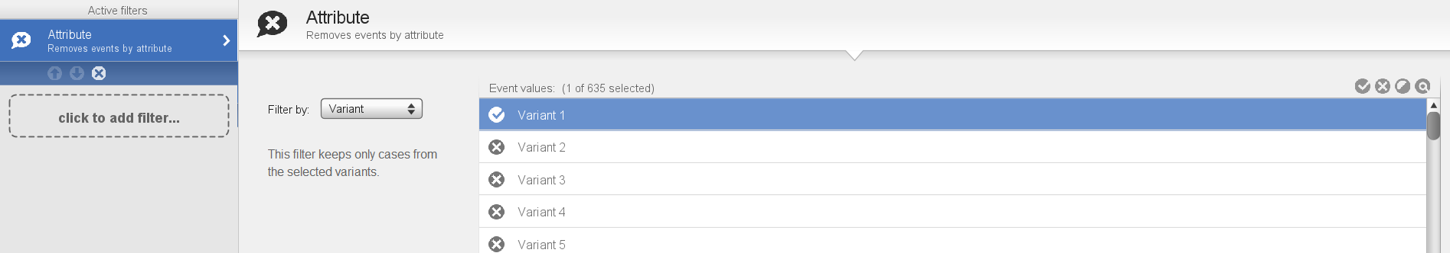
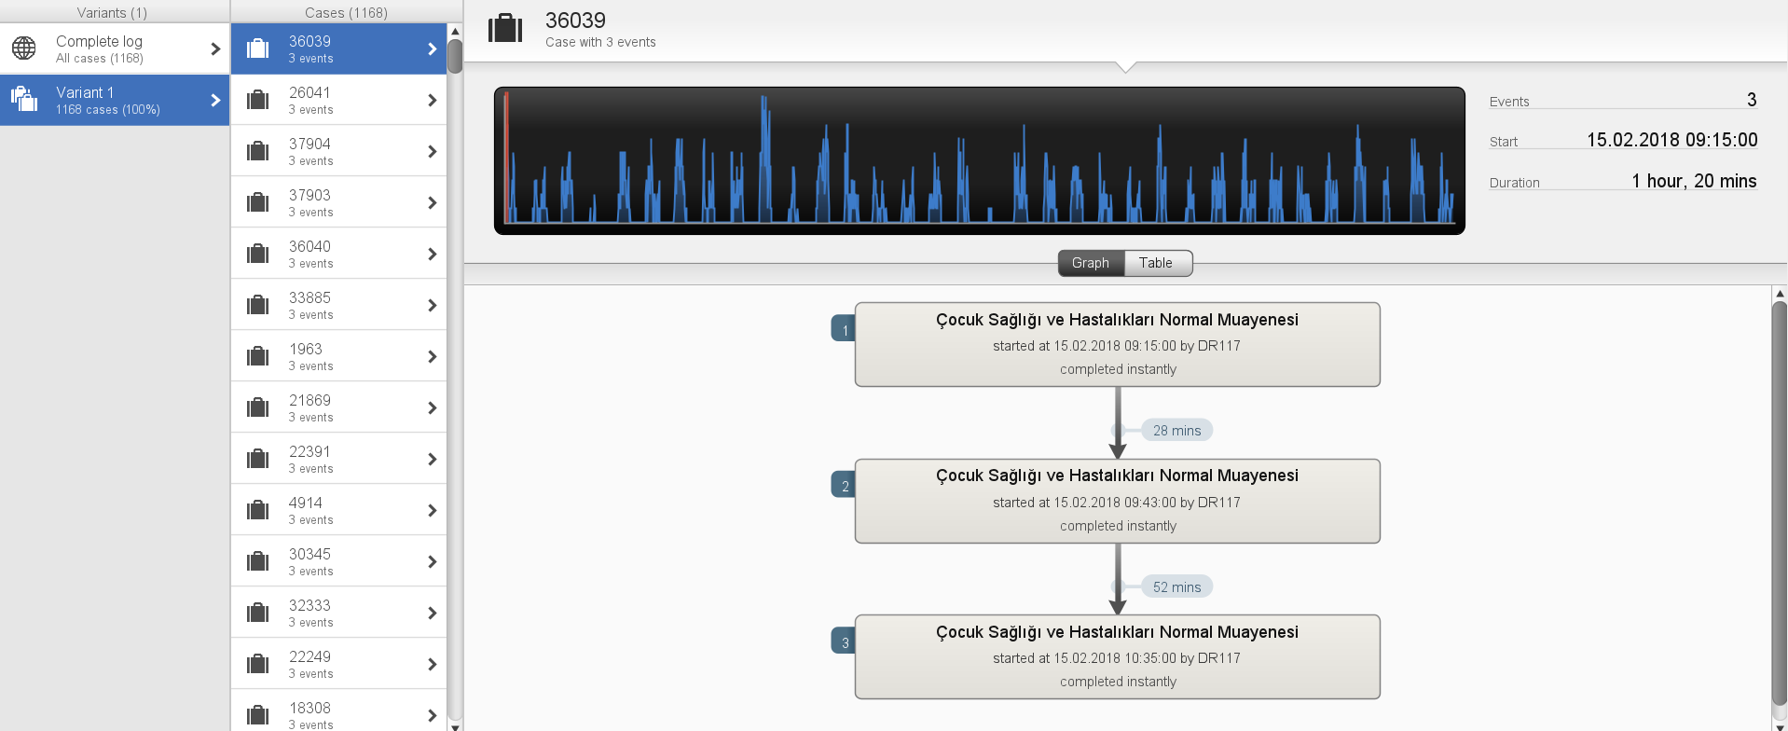
Waiting and Examination Times
We filtered Variant 1, that is, the route on the right, in order to examine the waiting and examination times of the Pediatry Normal Examination, which is the most used activity of the hospital.

Slide 44
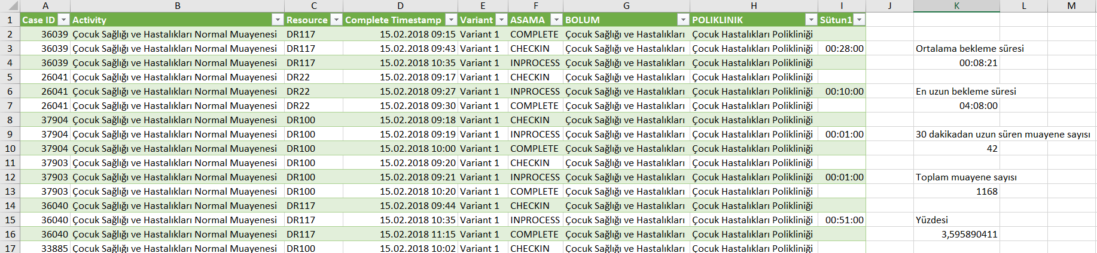
Waiting times
First, we examined the waiting times of the patients for the examination after check-in procedure.
After exporting the filtered data to Excel; we found the number of waits longer than 30 minutes to be 42. This number is approximately 3.6% of the total number of Pediatric Health and Diseases examinations.
Since this rate is very low, we can say that patients generally do not have a problem about waiting too long after the check-in.

Slide 45
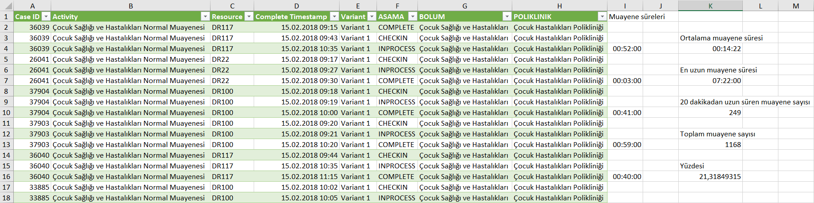
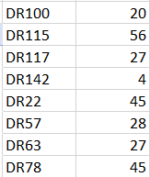
Examination times
Next, we looked at examination times.
By exporting filtered data to Excel, we found the number of examinations that took longer than 20 minutes to be 249. This number is approximately 21% of the total number of Pediatric Health and Diseases Examinations.
DR115, DR22 and DR78 performed these examinations the most. The lenght of examination periods can be discussed with these doctors. In order to reduce the Child Normal Examination, they may be asked to reduce their examination time.
Doktorların 20 dakika ve daha uzun muayene yapma sayıları

Slide 46
Part 3
Changing the start of the process
Department Recommendation System for normal examinations
Balancing the workload of the weekend
Balancing the workload
Checking the transition times from normal examination to control examination
Less used departments
Departments in more than one polyclinic

Slide 47
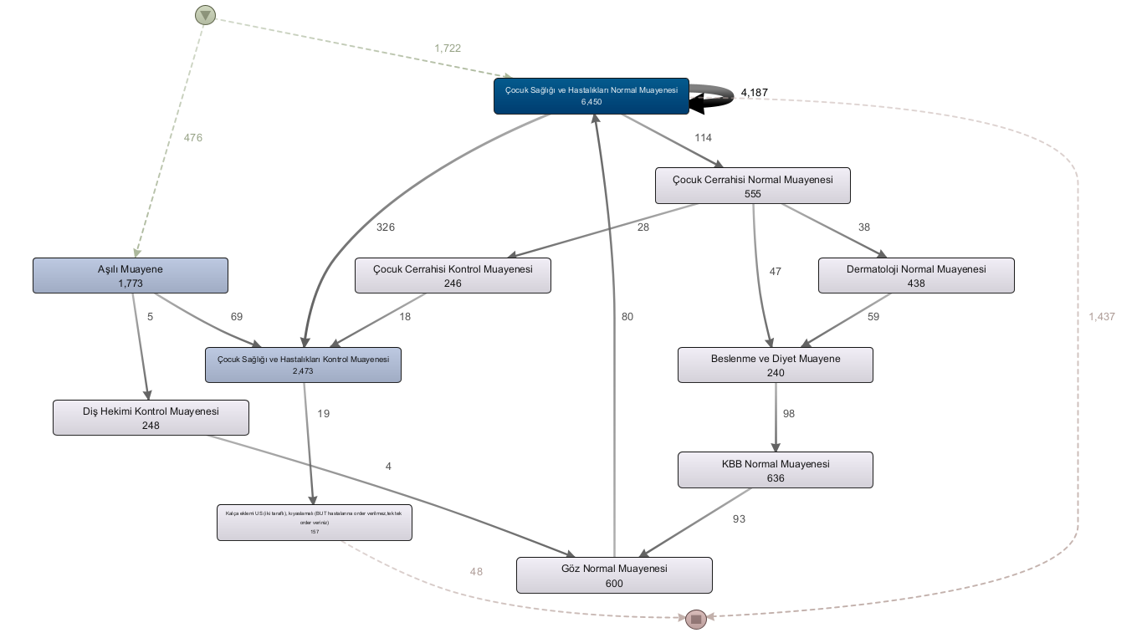
Old process map

Slide 48
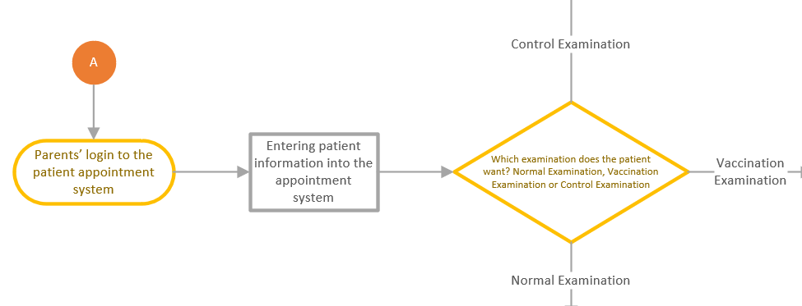
Changing the start of the process
In the old process, most of the incoming patients were distributed to other departments, if necessary, after the Pediatric Health and Diseases Normal Examination.
At the beginning of the newly designed process, the crowd in the normal examination was reduced by separating the patients who want to be vaccinated or who know that they should have a control examination.

Slide 49
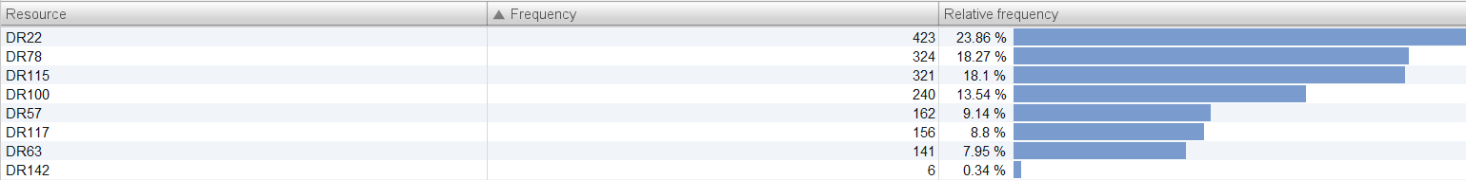
If parents want to make a vaccination appointment, they choose it in the appointment system at the very beginning of the process.
So, the visits to the Pediatric Health and Diseases Normal Examination seen before the vaccination appointment will be greatly reduced.
In addition, the choice of doctor will not be offered when scheduling a vaccination examination appointment.
In this way, the workload imbalance of the doctors who perform vaccination examinations, which can be seen in the table below, will also be resolved.

Slide 50
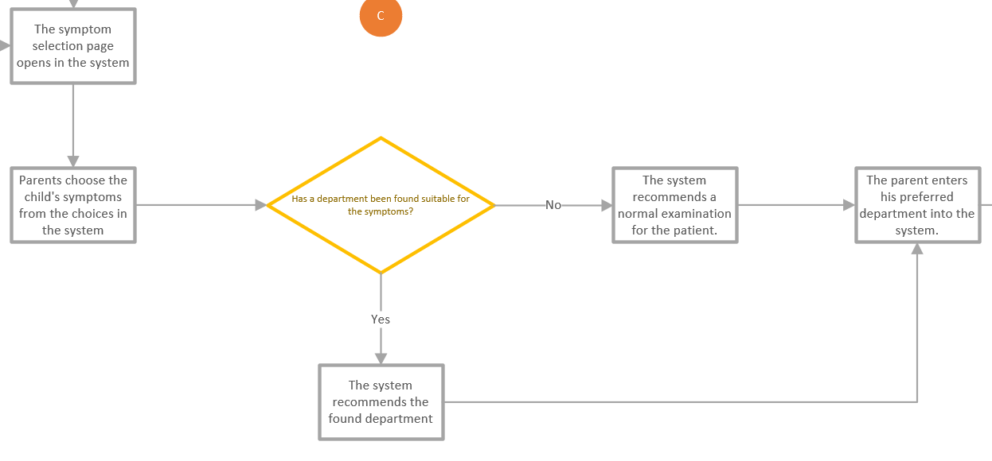
Department Recommendation System for normal examinations
In the old process, patients used to choose a department based on their own knowledge. This situation caused patients to go to the wrong departments so some departments in the hospital were busier than others.
In the new process, the parents of the patients; after selecting the patient’s symptoms from the choices in the system, the system recommends the department where the patient should choose.

Slide 51
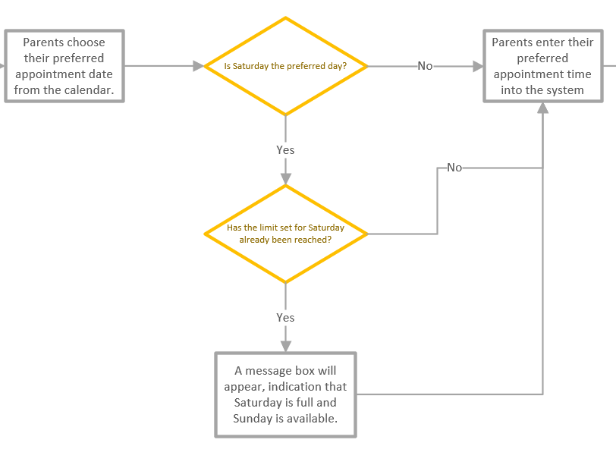
Balancing the workload of the weekend
In the old process, since there was no limit on the number of appointments to be made during the day, it is seen that the number of patients is too high on saturdays and less on sundays.
In the new process, examination limits are determined for all days of a week. If parents wnat to make an appointment on Saturday from patient appointment system; if the examination limit set for that Saturday has been reached and Sunday is available, parents will be shown a message box stating that Saturday is full and Sunday is empty.

Slide 52
Workload balancing
In the old process, the workload was not evenly distributed among the doctors, as can be seen when the two most used activites are filtered.

Slide 53
In addition, in the old process, 96 patients came back to normal examination.
Doctors examining patients who repeatedly come for a normal examination can be seen in the table below.
It was observed that these doctors were the doctors who made the most examinations in the whole process.
Since these doctors do too many examinations, it may cause a decrease in examination times and examination quality, and this may cause patients to return for another normal examination.

Slide 54
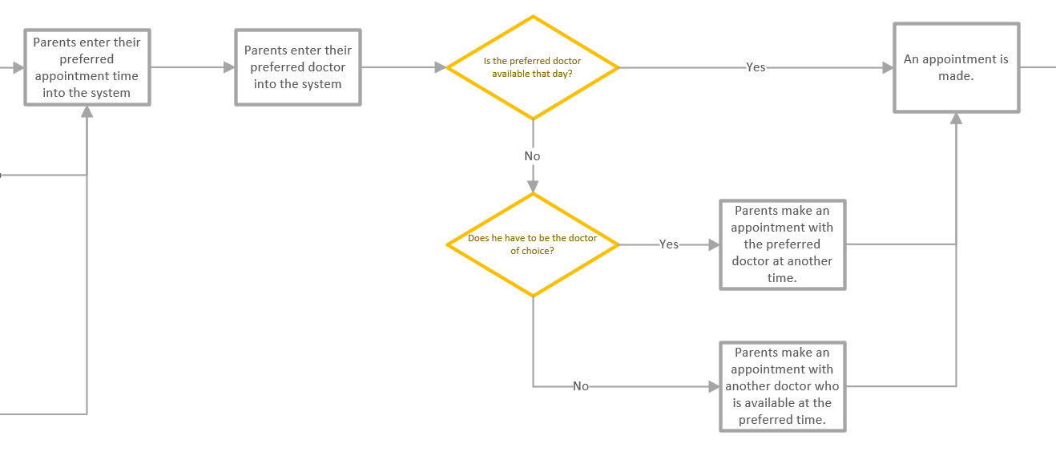
The mentioned workload imbalance and repetitive examination problems can be solved by making the workload of doctors more homogeneous.
In the new process, the number of examinations that each doctor can perform per day is limited.
Parents who want to make an appointment enter their preferred doctor and their preferred time into the system. If this doctor is available at this time, an appointment will be made.
If not, the system gives parents the option to make an appointment for a different time or with a different doctor.

Slide 55
Checking the transition times from normal examination to control examination
In the old process, after normal examination of the children, if the doctor wanted the patient to come for a control, the patient could come to the control examination whenever he wanted.
This caused the transition time to control examinations to be long and the crowding in the control examinations.

Slide 56
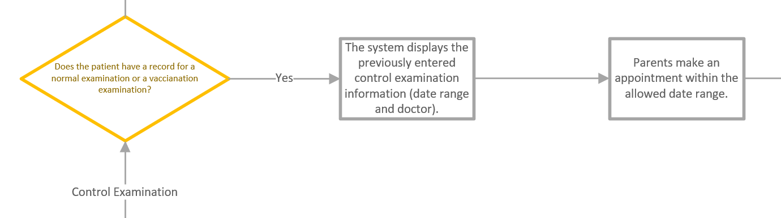

In the new process; if the doctor wants the patient to come for the control examination after normal examination, he enters the date range that he recommends the control examination to be made into the system.
Then, parents can choose a date within this range when making an appointment for the control examination.

Slide 57
Less Used Departments
In 12 departments with less than 100 frequencies, only 88 patients were seen during the whole process.
Sorting the departments by frequency

Slide 58
Solution Suggestions
Closing the departments with few patients and directing the patients who need these departments to other hospitals
Merging departments that will not cause organizational problems in the same polyclinic/floor.
Benefits of the solutions
Thus, the patient load of the polyclinics where the departments that are closed or merged elsewhere will be reduced.
Also, by closing departments or merging less-used departments elsewhere; personnel costs, electricity, water and heating costs etc. Arising from the settlement cost will decrease. In addition, space will be saved.

Slide 59
Departments in more than one polyclinic
There are departments in more than one polyclinic in the process.
For example, the ophthalmology department is located in both polyclinics in this table:
Organizational integrity can be achieved by combining such departments in a single polyclinic.

Slide 60
Final Visio chart of the new designed process

